Slide 1
Ion S5/S5xl Primary & Secondary Analysis Overview

Slide 2

Objectives for this part of the Training
Introduction: Data analysis part of Ion workflow
Understanding each step of the process
Notes:
Needs to be adapted per session – Here LAB
How do we do that? And Time frames
We will go into the lab!
X
How does this relate to your expectations – trainer to refer to flipcharts with expectations
Anything we need to or can add?
Needs to be in the update loop when content = description will change

Slide 3
Agenda
Primary data analysis workflow
Raw acquisition processing
Classification
Signal Processing
Base calling
Read Filtering and Trimming
Sequence alignment

Slide 4
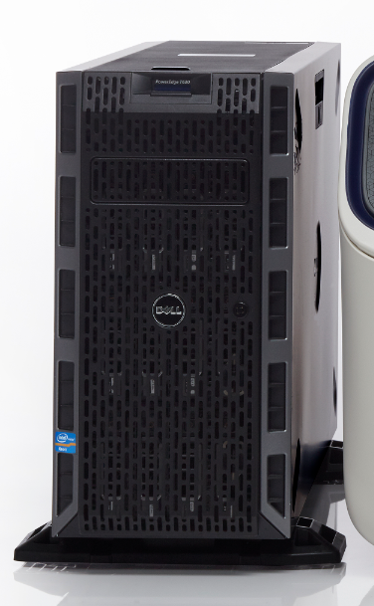

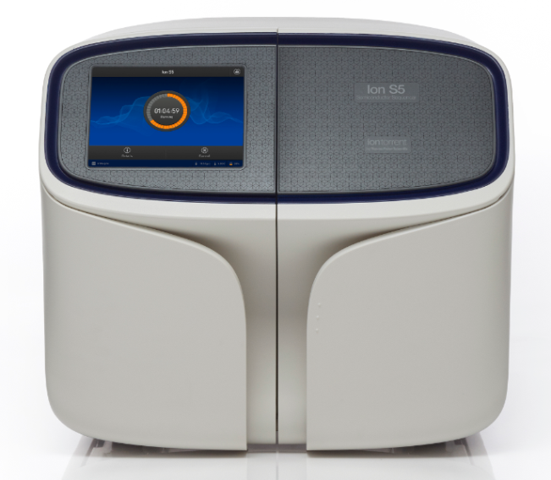


Data Analysis Workflow
Torrent Suite™
Ion Plugins
Torrent Browser
Third Party Software Packages
Raw/WELLS
Unmapped BAM
BAM
Torrent Server and Database
End User Computer
Ion Torrent™ Sequencer
Run Assessment
Data Delivery (Unmapped BAM)
To Bases
Single run analysis
Multiple run analysis
Notes:
data flows from the PGM to the Torrent Server.
At the Torrent Server, data is condensed and summarized into base calls.
The data is then hosted for review and delivery via a web browser.
It's important to note that on the Torrent Server, data is analyzed only for a single run.
If researchers want to compare data at the experimental level (by comparing multiple runs), then data is available for download using standard file formats which can be imported into a variety of either commercial or academic tools. Three such tools are shown here. These three are available for sale through the Ion Torrent web store.
4

Slide 5
Primary Data Analysis Workflow
Notes:
5
Ion Torrent Systems, Inc.

Slide 6
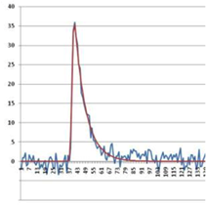
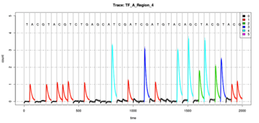
Torrent Suite Data Analysis Flow
Incorporation for
1 Flow (DAT)
Incorporation over
many flows (DAT)
Raw signals per flow (WELLS)
0.1 1.2 0.3 2.1 0.1 0.2 2.1 3.1 0.0
0.2 2.1 3.1 0.0 0.1 1.2 0.3 2.1 0.0
0.0 0.0 3.2 1.4 0.1 1.3 1.0 0.2 0.1
Signal Processing
Base Calling
FASTQ
Unmapped BAM file
with base calls
& raw normalized signals
(optional)
VCF
BAM
For details on file formats & data analysis,
see the full documentation on the Ion Community.

Slide 7
File format definitions
FASTA file
FASTA file originated in the 80s from FASTP program designed for protein sequence similarity searching and later DNA.
FASTA file is a text-based format for representing DNA sequences using single-letter codes.
A sequence in FASTA format begins with a single-line description starting with ‘>’, followed by lines of sequence data.
Bam file (Binary Aligment Map)
BAM file is a compressed version of the SAM (Sequence Alignment/Map) binary format. BAM uses an index file to give fast access to small sections of the file.
Nice tutorial to learn how to work with BAM files: (http://www.ncbi.nlm.nih.gov/tools/gbench/tutorial6/)

Slide 8
File format definition
FASTQ file
Text-based format for storing both a DNA sequence and its corresponding quality scores. Both are ASCII encoded.
VCF File (Variant Call Format)
Stands for Variant Call Format. It is a standardized text file format for representing SNP, indel, & structural variation calls.
BED file (Browser Extensible Data)
Tab-delimited text file that defines a feature track. BED file is added to a reference file.
http://genome.ucsc.edu/FAQ/FAQformat#format1.7
For more file definitions: http://www.broadinstitute.org/software/igv/FileFormats

Slide 9
Torrent Pipeline – Approximate Data Sizes*
Process Description
File Types
Ion 314™ chip
Ion 316™ chip
Ion 318™ / 520™chip
Ion PI™/540™ chip
Raw Voltage Data
DAT
28 GB
129 GB
242 GB
2 TB
Signal Processing
WELLS
1 GB
7-9 GB
12-15 GB
80-100 GB
Base Calls - Aligned
BAM
0.1 GB
1.7-2.0 GB
2.7-3.0 GB
40-60 GB
Base Calls - Flow
SFF
1 GB/
4.5-6.0 GB/
8-10 GB/
100-120GB
Base Calls - Base
FASTQ
0.2 GB
1-1.25 GB
1.8-2.25 GB
20-30 GB
*v3.0 250 bp run (500 flows) Sept2012. The information presented here is an approximation.
User experiences may vary.
Notes:
Each flow during PGM sequencing produces a DAT file (also called ACQ files for acquisition). These files represent the raw voltage measurements from the PGM. These are transferred from the PGM to the Torrent Server and then processed into Wells files, followed by standard sequencing output files, SFF and FASTQ. Users that are able to store the raw DAT files will be able to take full advantage of s/w updates. At least users should be able to store the intermediate Wells files, from which they can re-process runs with new s/w as well. Details in the Torrent Dev section of the Community.
All of the DAT files (4 files per cycle) are condensed into a single 1.wells file for a single run. This represents “processed signal”.
Then a base calling algorithm is applied to these data which outputs a single SFF file. SFF files contain data in “Flow Space”. Many secondary analysis applications accept SFF files. However, to ensure that data are fully compatible with downstream applications, another conversion is performed to produce a FASTQ file, which contains largely the same type of data as the SFF but in a slightly more compressed format.
454 data typically comes in SFF format, while ILMN data comes in FASTQ formats.
Lastly, it’s important to note that once a run is completed, there are processes to “archive” the raw data away from the Torrent Server to free up space for your next runs. Since the bulk of the space is taken by the DAT & SFF files, removing these to an archive location is a good practice. Tools exist within Torrent Browser to aid this archiving process.
Other assumptions –0.86 addressable wells, 53% loading, 73% keypass

Slide 10
Overview workflow
DAT Processing
Classification
Signal Processing
Base Caller
Read Filter
Alignment
Notes:
DAT processing performs the following functions:
Raw acquisition data loading into memory. This includes decompressing the data files. Data is compressed when it is streamed off the PGM sequencer:
An optional dynamic frame rate compression mode whereby various portions of the incorporation event throughout the nucleotide flow duration are captured at different frame rates. The variable frame rate permits biologically specific events to be captured with high resolution while averaging multiple frames where appropriate, giving a reduction inoverall file size.
A compression approach may use a keyframe/delta compression technique whereby an initial value is stored, followed by the changes in that initial value, rather than storing the actual value each time. This results in a nearly 2x reduction in file size.
Raw measurement offset corrections. Raw acquisition data are stored using the values output by the chip. Each well has its own reference value, and to compare well to well, the two wells may use a common reference. The offset correction takes the average of the first few frames within each acquisition file and subtracts that value from each well, thus permitting well measurements to have a common reference value.
Pinned well identification. Due to the nature of the chip output voltages, a range of values exists for any given chip. The PGM sequencer calibration code brings the majority of wells within range of the hardware analog to digital converters. The output is a distribution of values centered around the center voltage. Wells that reside outside a selected distribution are considered "pinned" (functional wells outside of the range of the Analog to Digital Converter (ADC)). These pinned wells typically represent fewer than one percent of the total available wells.
Excluded Wells. Various flow cell configurations often make tradeoffs on flow velocity profiles and chip coverage areas. For the Ion 314 chip, for example, a percentage of the wells are covered by the flow cell and are not fluidically addressable. A mask is loaded, per chip type, to mark those wells as excluded so they do not complicate down-stream processing of the chip.

Slide 11
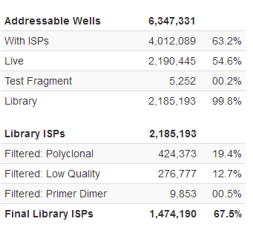
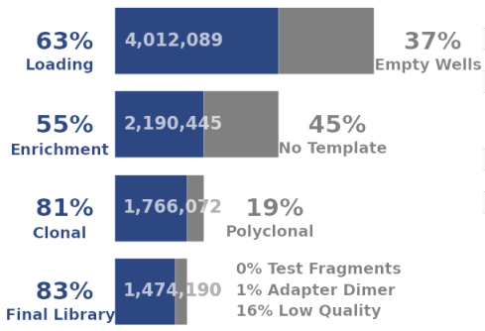

Classification
.dat
Raw Acquisition data
DAT Processing
Classification
Empty
.dat + bfmask.bin
Signal Processing
Used for
background
estimation
Base Caller
Live
Dud
Low sequence
signal
Read Filter
Alignment
TF
?
Library
Mask
Notes:
Classification
Classification is the process of determining the contents of each well on the chip. The primary purpose of classification is to determine which wells contain particles with template for sequencing and which wells are empty for use in background estimation during signal processing. The figure below illustrates the nested classes of classification.
A well can either be empty, contain a particle or be flagged as an outlier. Wells are flagged as outliers if they do not appear to be responding appropriately to the nucleotide, are not fitting the model well or are wells marked empty that appear to be buffering. For wells containing a particle, the process additionally determines if the particle is:
A library particle.
A test fragment (control) particle.
A dud particle (a particle that does not produce a sufficiently strong sequence signal).
It is important to note at this point that classification is not simply processing the entire chip as one group. As is mentioned for other pipeline modules, the chip is processed in smaller regions. An Ion 314 chip, for example, is divided into on the order of 50x50 well regions, resulting in about 625 total regions. This enables processing many small regions in parallel and taking advantage of multi-core/multi-process compute nodes that have such capabilities. More importantly, regions in the chip are processed that contain fluidically similar wells, where smaller regions tend to be relatively homogeneous and facilitate comparing wells to each other within a region.
Key Classification
Each well is checked to see if it is producing sequence that matches any one of the keys. A model is fit and the key with the best fit is assigned to that well. If no key has a high enough score then the well is not assigned to the live classification and will not be processed downstream.
With the default keys and flow order, above, there are two vectors in flow space:
Nuc Flow: TACGTACG Library: 1010010 Test Frag: 0100101
Each key is tested to see if it fits the expected behavior of similar signals in the 1mer flows and no signal in the 0mer flows. Note, as mentioned above for these keys, the last 'G' flow is not used in the model fitting. There could be another G following in the template sequence which would mean that in some cases the incorporation may be a 2mer, 3mer, etc. and not fit the model. A key must have at least two 1mer flows and two 0mer flows to be valid for sequencing.

Slide 12
Signal Processing
“The Background Model”
.dat
DAT Processing
Background signal estimation from empty wells
Subtracting the background signal
Generating raw incorporation signal measure per well (1.wells)
Classification
.dat + bfmask.bin
Signal Processing
.wells
Base Caller
Read Filter
Alignment
Notes:
Signal Processing
The signal processing module focuses on wells containing particles, which is now using the mask information in addition to the raw acquisition data. The following figure shows a conceptual representation of the signal measured in a well during an incorporation event.
This signal has additional components, referred to as "the background". This background part of the signal is present during each flow and can vary over time, across the chip, and during an acquisition. The signal processing problem can be thought of as having two parts:
The first part involves deriving the background signal that would have been measured in a given well, had no incorporation occurred.
The second part involves subtracting (or fitting) the background signal and examining (or fitting to) the remaining signal. The output of the incorporation fitting model produces the estimate of the incorporation at each nucleotide flow for each well.
At this point, the output from the analysis pipeline is a raw incorporation signal measure per well, per flow, stored as a 1.wells file.

Slide 13
Base Caller
DAT Processing
The basecaller module performs signal normalizations, phase and droop estimations, signal fittings, and declares bases for each flow of each well. It outputs non-incorporation events in addition to incorporation events. The unmapped BAM file stores all such calls.
Classification
Signal Processing
.wells
Base Caller
Read Filter
Alignment
Notes:
Basecalling
The basecaller module performs signal normalizations, phase and droop estimations, signal corrections, and declares bases for each flow of each well. It outputs non-incorporation events in addition to incorporation events. The SFF output file stores all such calls.
The following figure shows basecaller phase correction:
Droop estimation
Observed signal droop can be attributed to DNA polymerase loss that can occur during a sequencing run. Typically, such loss is experienced only during incorporation events, and typical values are in the 0.1 to 0.2% range over the course of a run. By averaging groups of reads in a region together and averaging their measured signals, an exponential can be fit to the resulting curve, and the rate of signal loss over time is extracted. Thus, an estimate of the polymerase loss during incorporation events can be determined.
Phase estimation
Once the droop has been established, it is used in the phase model as a constant for each read. Droop estimates can still vary across the chip, but is assumed fixed for each processed region. The model then fits the carry-forward and incomplete extension parameters for each read, over a limited number of flows and excluding certain flows. The output from this fit is an estimate of the carry-forward (CF) and incomplete extension (IE) for each well. The values are averaged over small regions to reduce errors and noise in the fit. The output CF and IE values are used as inputs to the solver.
Solver
The solver uses the measured incorporation signal, the phase estimates, and the droop estimates to determine the most likely base sequence in the well. The solver achieves this by repeatedly constructing predicted signals for partial base sequences and evaluating their fit to the measured signal. The predicted signals are generated by a highly efficient dynamic programming algorithm. These signals are further used by the solver to perform a branch-and-bound search through the tree of partial base sequences. The solver keeps a list of promising partial sequences. At each step, it selects the most promising sequence and extends it by one base into four new longer partial sequences. These new candidates are checked against a set of fit criteria, and those that pass them are added to the list. The list size is limited and the excess sequences are discarded based on a fit heuristic. When none of the entries on the list yield a better fit than the best sequence examined thus far, the tree search concludes.
Normalization
The solver expects that in absence of phasing and droop, the measured signal for flows incorporating a 1-mer is very close to 1, and for non-incorporating flows very close to zero. In practice, the measured incorporation signal can deviate from this assumption by an additive offset and a multiplicative scaling that slowly varies with the flow number and is different for each read. This is addressed by normalizing the signal before it is passed to the solver. Before the first execution of the solver, a key normalization preliminarily scales the measurements by a constant factor. The factor is selected to bring the signal of the known expected 1-mers produced by sequencing through the key as close to unity as possible. Once the solver has guessed a sequence, the corresponding predicted signal is leveraged for adaptive normalization. Adaptive normalization compares the predicted signal to the measured incorporation signal to fit the flow-varying additive and multiplicative terms, and subsequently generates an improved normalized signal with the distortion removed (or at least reduced). Adaptive normalization is invoked iteratively with the solver for several rounds, allowing the normalized signal and the predicted signal to converge towards the best solution.

Slide 14
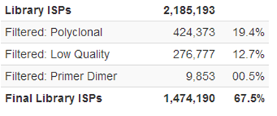
Read Filter
DAT Processing
Polyclonal (mixed-template reads)
Low quality (when fit to a predictive model of phasing effects)
Primer-dimer
3’ adapter trim
Quality trim
Classification
Signal Processing
Base Caller
More 0-signal flows
signals no longer cluster exclusively
around integers
Read Filter
.bam
Alignment
.bam
Monoclonal Read
Polyclonal Read

Slide 15
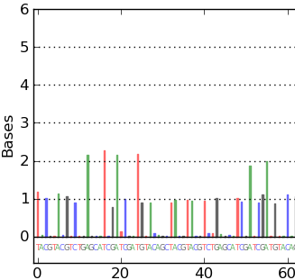
Read Filter – Low quality
Bad Key
Infinite signal
Poor fit to a predictive model of phasing effects
Flow residual = observed – predicted
Low quality median absolute residual in first 60 flows above 0.08
(or 0.06 for other flow orders including TCAG, SAMBA = 0.08)
We would predict a nearly perfect 2.0 at the beginning of a run, these flows are observed to be above that prediction. The filter calculates the median of the absolute value of all such residual errors in the first 60 flows.

Slide 16
Read Filter – Primer-dimer
If read length is less than 25 bp after adapter trimming,
read is considered to be a primer-dimer

Slide 17
Read Filter – 3’ adapter trim
ATCACCGACTGCCCATAGAGAGGCTGAGAC
Convert to flow-space
Search in flow-space for matches between suffix of read and prefix of expected adaptor
Clip based on how well it fits. Even a single base can
be clipped if it matches the adapter
[PCR Primer] are optional, depending the LC method
Adapter A Barcode PCR * template PCR* P1Adapter
Key Tag (TF Key, Lib Key)

Slide 18
Quality Trimming
Notes:
18
Ion Torrent Systems, Inc.

Slide 19
Quality Values
The predicted quality values are reported on the Phred scale, defined as -10×log10 (error probability)
predict the probability of correct base call
The prediction is based on the quality of the base incorporation signal that was used to generate the base calls
6 predictors are used
A Phred lookup table is used for converting the values of predictors to error probabilities
The lookup table is generated from prior runs across multiple genomes and instruments
Notes:
The Per-Base Quality Score System
Overview
The Ion Torrent per-base quality score system uses a Phred-like method to predict the probability of correct base call. The prediction is based on the quality of the base incorporation signal that was used for generating the base calls. The Personal Genome Machine (PGM) quality score system uses a set of 6 predictors whose values are correlated with the probability of a base miscall. A Phred lookup table is used for converting the values of predictors to error probabilities. The lookup table is generated by training on a representative data set in customer configuration. The lookup table is re-trained for each PGM software release and is shipped as part of the software package. Quality scores are published in the SFF, FASTQ, and SAM files. Quality Score Predictors
Torrent software uses the following six predictors that are correlated with empirical base call quality: P1 Penalty Residual : A penalty based on the difference between predicted and actual flow values. Computed by the base caller. P2 Local noise : Noise (defined as the maximum absolute difference between the flow value and the nearest integer) in the immediate neighborhood (plus/minus 1 base) of the given base. P3 Signal separation : A separation between 0-mer and 1-mer signals at the start of the read, as measured by the mean and standard deviation of all 0-mers and 1-mers in the read: P3 = -(m1 - m0 - s1 - s0)/m1 , where m0 and m1 are mean 0-mer and 1-mer signals, and s0 and s1 are mean standard deviations of 0-mer and 1-mer signals. P4 Multiple incorporations : For multiple incorporations of the same nucleotide in one flow, the last base in the incorporation order is assigned a value equivalent to the total number of incorporations. All other bases in the sequence of the multiple incorporations are assigned the value 1. P5 Penalty Miscall : The increase in penalty residual (see P1) if the second best candidate sequence is used by the base caller. Measures certainty about the emitted sequence as compared to the alternative sequences. P6 Environment noise : The average signal noise (defined as the absolute difference between the flow value and the nearest integer) in the neighborhood (plus/minus 5 bases) of the given base.

Slide 20
Predictors
Penalty Residual : A penalty based on the difference between predicted and actual flow values. Computed by the base caller.
Local noise (1-base noise): Noise (max difference between the flow value and the nearest integer) in the immediate neighborhood (+/- one base).
High Residual Flows: number of high-residual flows in the 20-flow window around the flow containing the base
Multiple incorporations : For homopolymers, the last base in the incorporation order is assigned the total number of incorporations. Other bases in the homopolymer are assigned the value 1.
Environment noise (10-base noise) : Noise (max difference between the flow value and the nearest integer) in the neighborhood of given base (+/- ten bases).
State Inphase: Live polymerase in phase
Notes:
The Per-Base Quality Score System
Overview
The Ion Torrent per-base quality score system uses a Phred-like method to predict the probability of correct base call. The prediction is based on the quality of the base incorporation signal that was used for generating the base calls. The Personal Genome Machine (PGM) quality score system uses a set of 6 predictors whose values are correlated with the probability of a base miscall. A Phred lookup table is used for converting the values of predictors to error probabilities. The lookup table is generated by training on a representative data set in customer configuration. The lookup table is re-trained for each PGM software release and is shipped as part of the software package. Quality scores are published in the SFF, FASTQ, and SAM files. Quality Score Predictors
Torrent software uses the following six predictors that are correlated with empirical base call quality: P1 Penalty Residual : A penalty based on the difference between predicted and actual flow values. Computed by the base caller. P2 Local noise : Noise (defined as the maximum absolute difference between the flow value and the nearest integer) in the immediate neighborhood (plus/minus 1 base) of the given base. P3 Signal separation : A separation between 0-mer and 1-mer signals at the start of the read, as measured by the mean and standard deviation of all 0-mers and 1-mers in the read: P3 = -(m1 - m0 - s1 - s0)/m1 , where m0 and m1 are mean 0-mer and 1-mer signals, and s0 and s1 are mean standard deviations of 0-mer and 1-mer signals. P4 Multiple incorporations : For multiple incorporations of the same nucleotide in one flow, the last base in the incorporation order is assigned a value equivalent to the total number of incorporations. All other bases in the sequence of the multiple incorporations are assigned the value 1. P5 Penalty Miscall : The increase in penalty residual (see P1) if the second best candidate sequence is used by the base caller. Measures certainty about the emitted sequence as compared to the alternative sequences. P6 Environment noise : The average signal noise (defined as the absolute difference between the flow value and the nearest integer) in the neighborhood (plus/minus 5 bases) of the given base.

Slide 21
What does Q20 mean?
Q20 corresponds to a predicted error rate of one percent
The Torrent Suite Software™ reported Q20 value is the number of filtered bases with a predicted quality >= 20
Refer to http://en.wikipedia.org/wiki/Phred_quality_score for a more complete description of Phred values
Notes:
21

Slide 22
Quality Values - Phred-like score

Slide 23

Low QV filtering
Remove lower-accuracy trailing bases
Basecalling accuracy reduces as read length increases
Causes include accumulation of phase errors and loss of signal
Filter Stringency will depend on application
‘Counting’ applications (CNV, RNASeq, etc) often require only that the sequence be mappable
Detection of low-frequency variants would require higher accuracy
General goal is to trim un-alignable trailing ends
Notes:
Ion Community, Torrent Dev, Documents, Technical Note – Filtering & Trimming
http://lifetech-it.hosted.jivesoftware.com/docs/DOC-2070
http://lifetech-it.hosted.jivesoftware.com/videos/1643

Slide 24

How is trimming performed?
Trimming is based on Quality
Implemented in Basecaller
Trim based on predicted quality values Using QVs
Trimmed bases are hard clipped – not present in the unmapped BAM file output
Notes:
Ion Community, Torrent Dev, Documents, Technical Note – Filtering & Trimming
http://lifetech-it.hosted.jivesoftware.com/docs/DOC-2070
http://lifetech-it.hosted.jivesoftware.com/videos/1643

Slide 25
Quality Trimming – per base quality scores
Evaluate average per-base quality in a sliding window of size 30
Trim the read at the center position in the window the first time the moving average drops below 15
30bp, Avg QV = 6
30bp, Avg QV = 25
Notes:
One consequence 3% => roughly 1 in 33 => periodicity of around 30 bases or so

Slide 26
Sequence Alignment
Notes:
26
Ion Torrent Systems, Inc.

Slide 27
The Torrent Mapper - TMAP
Specifically designed for Ion Torrent™ Products :
Map variable read lengths
Principal error model relates to long homopolymer misscalls mostly resulting in insertion or deletion errors during alignment
Performance
Multi-threaded (speedup scales linearly)
Sensible defaults, but exposed parameters
Low memory (BWT/FM-index)
full-text substring based on the Burrow-Wheeler transform
Seed and extension
Source code available from Ion Torrent™ Dev community (GPLv2 License)
Can be compiled on any standard *nix system

Slide 28
TMAP
Can be compiled on any standard *nix system
Integrates 3 popular alignment algorithms
BWA-short (Li and Durbin, 2009) (<150bp)
Burrows-Wheeler Transform algorithm, gapped alignments
BWA-long (Li and Durbin, 2010) (>= 150bp)
Burrows-Wheeler Transform algorithm, heuristic Smith-Waterman-like alignment to find high-scoring local hits
SSAHA (Ning et al, 2001) (>= 150bp)
Hash table algorithm
Super-maximal Exact Matching (Li 2012) – Default
Li, H, Durbin, R (2009). Fast and accurate short read alignment with Burrows-Wheeler transform. Bioinformatics, 25, 14:1754-60.
Li, H, Durbin, R (2010). Fast and accurate long-read alignment with Burrows-Wheeler transform. Bioinformatics, 26, 5:589-95.
Ning, Z, Cox, AJ, Mullikin, JC (2001). SSAHA: a fast search method for large DNA databases. Genome Res., 11, 10:1725-9.
Li, Heng (2012). Exploring single-sample SNP and INDEL calling with whole-genome de novo assembly. Bioinformatics, 28, 14:1838-1844.
Notes:
Heuristic ( /hjʉˈrɪstɨk/; or heuristics; Greek: "Εὑρίσκω", "find" or "discover") refers to experience-based techniques for problem solving, learning, and discovery. Where an exhaustive search is impractical, heuristic methods are used to speed up the process of finding a satisfactory solution. Examples of this method include using a rule of thumb, an educated guess, an intuitive judgment, or common sense.

Slide 29
TMAP Workflow
Seed
Union the hits from all the mapping algorithms
Extend
Score the hits with Smith Waterman
Filter and output the hit(s)
Output

Slide 30
Default Command
The default can be found under the generated BAM header
tmap mapall -n 12 -f <FASTA> -r <BAM> -v -Y -u -o 0 stage1 map4
Stage1: we could specify multiple stages…
Map4: super maximal exact matching algorithm
-n number of threads
-v verbose
-Y include flow space specific SAM tags when available
-o output type 0 (SAM), 1 (BAM, 2 (uncompressed BAM)
Default Scoring:
Match +1
Mismatch penalty -3
Gap open penalty -5
Gap extension penalty -2

Slide 31
Extension & Scoring example…
Reference contigs or Chromosomes
Region 1
Region 2
Read
Seed
Region 1
Region 2
Ref
ACGTGCAGCTGTTCGTGCGCTGCGA
Ref
ACGTGCAGCTGTTCGTGCGCTGCGA
Read
x
Read
ACGTGCAGCTGTTCGTGCCCTGCGA
ACGTGCAGCTGTTCGTGC TGCGA
Seed
-3
Seed
-5-2
Score = 18
Extension
Score = 18
Extension
Score = 15
Score = 13
Score = 16
Score = 11
Score = 21
Score = 16

Slide 32
Miscellaneous Features
Any combination of 5’/3’ soft-clipping (only 3’ by default)
FASTA, [FASTQ], [SFF], SAM, BAM inputs, BAM output
Inputs can be gzip or bzip2 compressed
Easy input to annotate SAM RG tags, outputs MD/NM tags
Server mode
Index is loaded into shared memory
Supports IUPAC bases Print alignments (from SAM/BAM) in flow space
[ ] - optional

Slide 33
AQ20 Metric
Alignment of reads can be a useful process to assess the quality of the sequencing reaction and the quality of the underlying library where an accurate reference is available.
Any discrepancy in alignment to a reference (whether biological or technical, meaning a real variant or a sequencing error) is listed as a mismatch
AQ20 length of a read is the longest length at which the aligned read has a mismatch rate of 1% or less
AQ20 content is the sum of all the AQ20 lengths
Notes:
33

Slide 34
AQ20 - caveat
The underlying assumption is that the reference to which the read is aligned represents the true sequence that should have been seen.
Suitable caution should be taken when interpreting AQ20 values in situations where the sample sequenced has substantial differences relative to the reference used, such as working with alignments to a rough draft genome or with samples that are expected to have high mutation rates relative to the reference used.
In these situations the AQ20 lengths might be short even when sequencing quality is excellent.

Slide 35
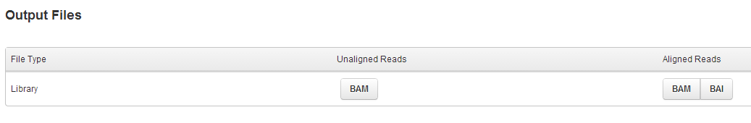
Output files: BAM files
Aligned and unaligned read files provided
Can import into IGV, UCSC, or favorite viewer

Slide 36
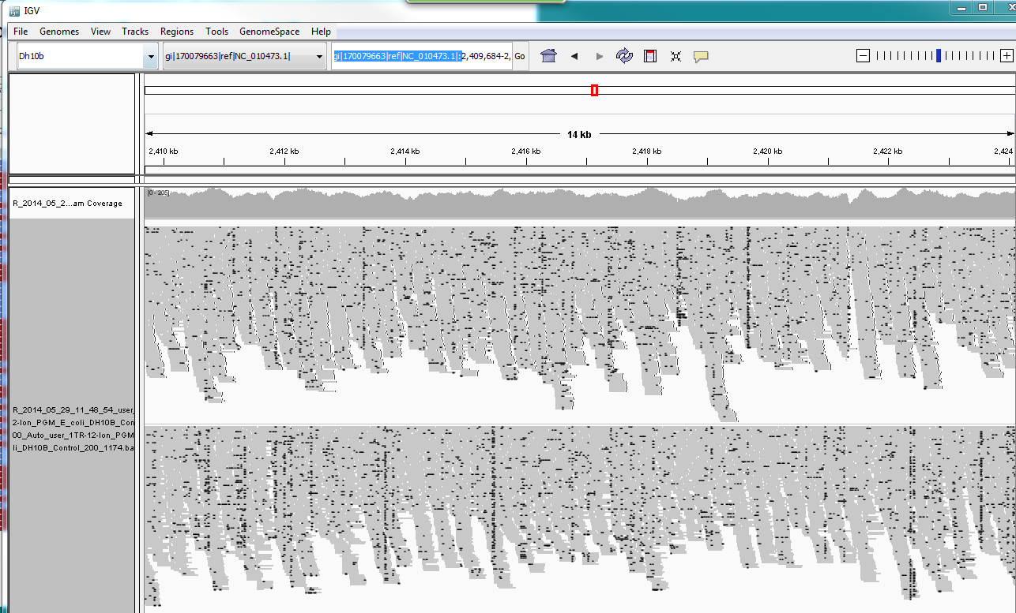
IGV (Interactive Genomics Viewer)
http://www.broadinstitute.org/software/igv/download

Slide 37
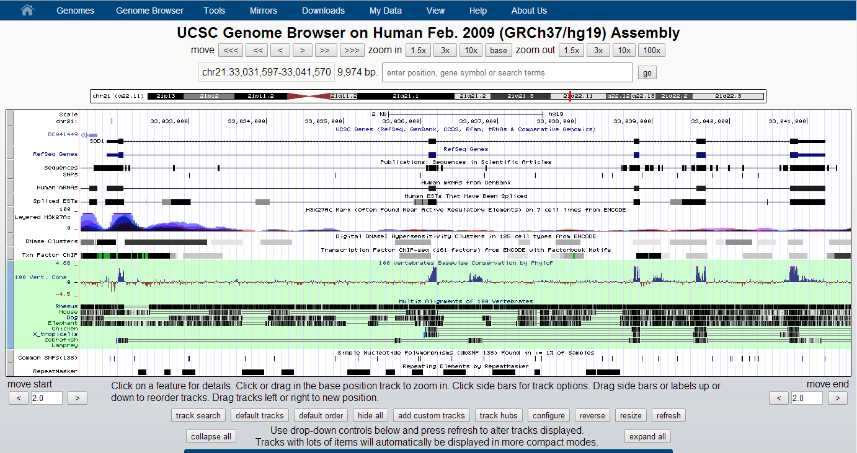
UCSC Genome Browser
http://genome.ucsc.edu/cgi-bin/hgGateway

Slide 38
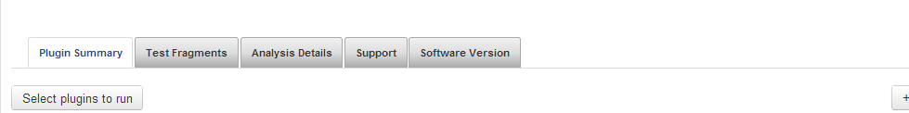
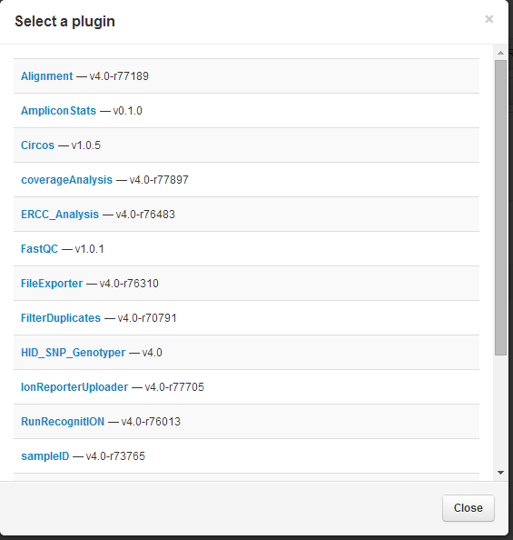
Plugins
Notes:
Amplicons Stats if running AmpliSeq,

Slide 39
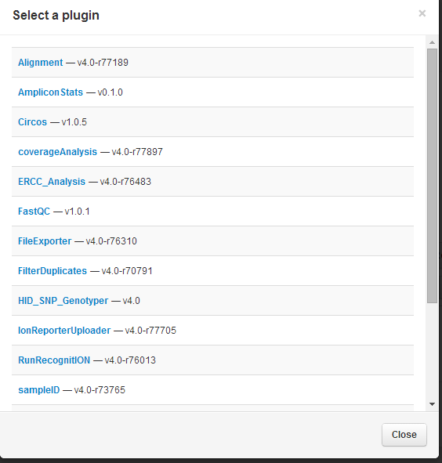
Plugins: FileExporter
1. Select FileExporter plugin to export FASTQ, SFF and variant caller files

Slide 40
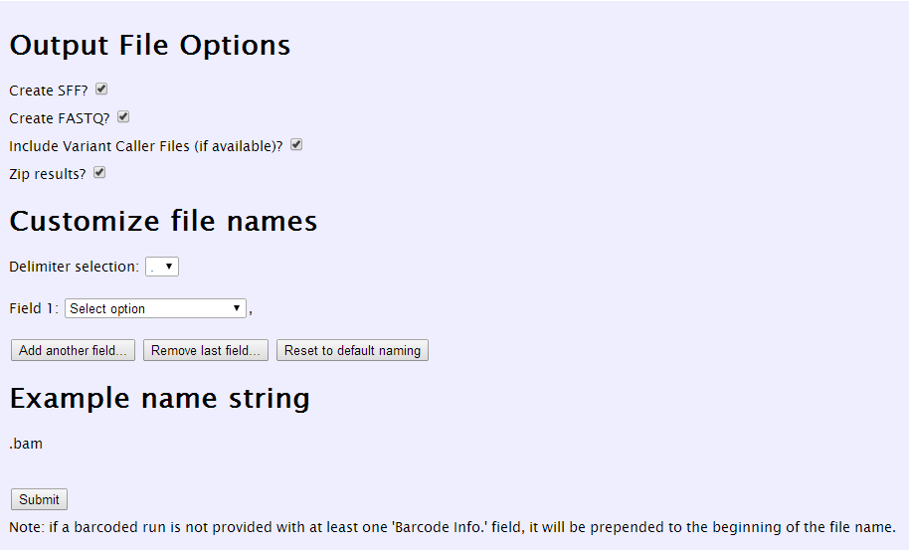
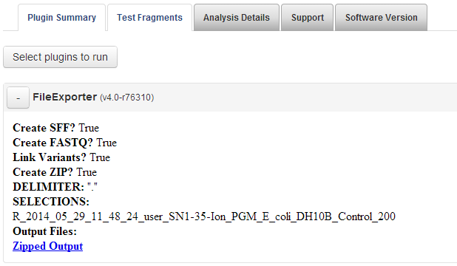
Plugins: FileExporter Plugin
2. Select options, which files to export and click submit.
3. Files will be generated and listed under the File Exporter Plugin in Plugin Summary at bottom of run report

Slide 41
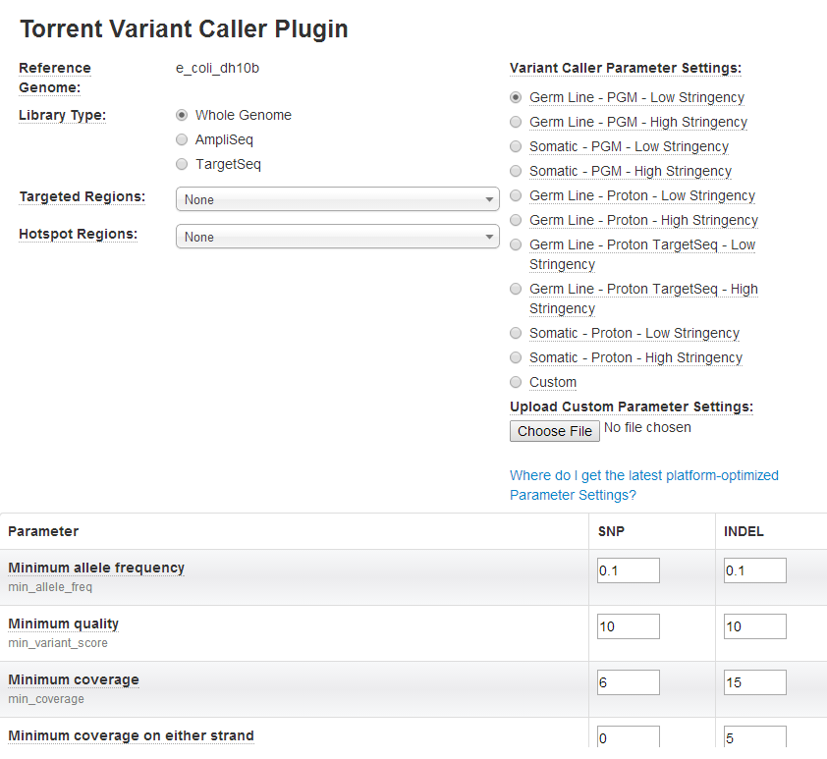
Plugins: Variant Caller

Slide 42
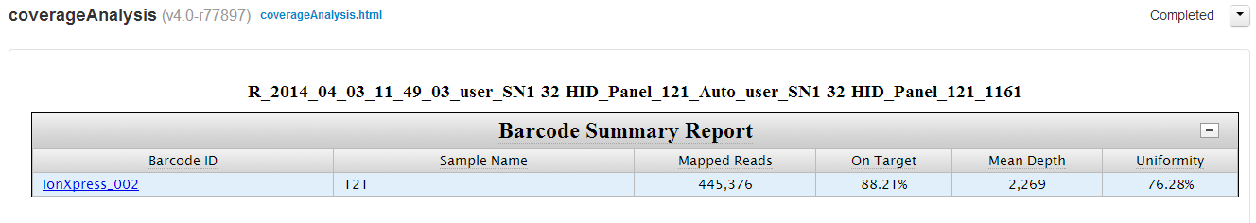
Plugins: CoverageAnalysis
Coverage stats for each barcode is displayed.

Slide 43
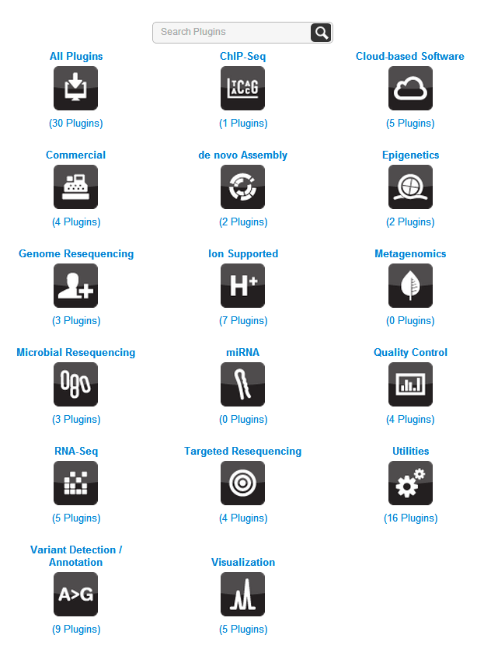


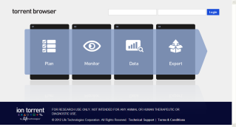
Torrent Browser Plugin Store & Torrent Suite™ Plugins
Your application. Your data. Your Plugin.
The App Store for Torrent Suite™ software
https://ioncommunity.thermofisher.com/community/products/software/torrent_browser_plugin_store
Notes:
The flexibility of Torrent Suite Software allows users to develop plugins, which are stand alone programs, that add functionality to Torrent Suite. So if users have their own pipelines in house or favorite piece of software, as long as it can be run from a command-line, it can be done within a plugin.
Here are several examples of how the framework has been leveraged to make use of open-source tools, published methods, and commercial software to develop a plugin to address a specific analysis need.
Assembler: This is a de novo assembly plugin that makes use of the open source package MIRA which has paramters specific for the Ion Torrent platform along with some additional parameters preset that we have found to work most optimally with internal runs. The output contains a simple report containing common assembly metrics such as N50, and N90 along with the number of contings and a like to the FASTA file containing the assembled contings.
IsoEM: This plugin was developed by the University of Conneticut and implements a novel method published by the Mandoiu lab in 2011 to predict transcript iso-forms in RNA-seq data. The plugin not only predicts these iso-forms, but uses UCSC’s Genome Browser to visualize them. The plugin also produces the gene and transcript level FPKM values which can be used to compute differential expression across samples.
snpEff: An important aspect of variant detection is the biological impact of the variants. snpEff is an open source program that annotates and summarizes variant called by any of the Ion Torrent variant caller plugins (Germ-line, AmpliSeq, and Torrent Variant Caller). It produces a rich report summarizing the variants by type and potential impacts and also generates an annotated VCF file for further downstream analysis.
NextBioXfr: Many institutions are utilizing cloud-based resources in their data analyses. NextBioXft, developed by cloud provider NextBio, is a plugin which allows users to directly link the data generated on their Torrent Server with their NextBio account so that when the sequence data is generated, it is automatically copied into their account in the cloud and the report provides a simple link that with one click brings the user into the analysis space for that datasets.
43

Slide 44
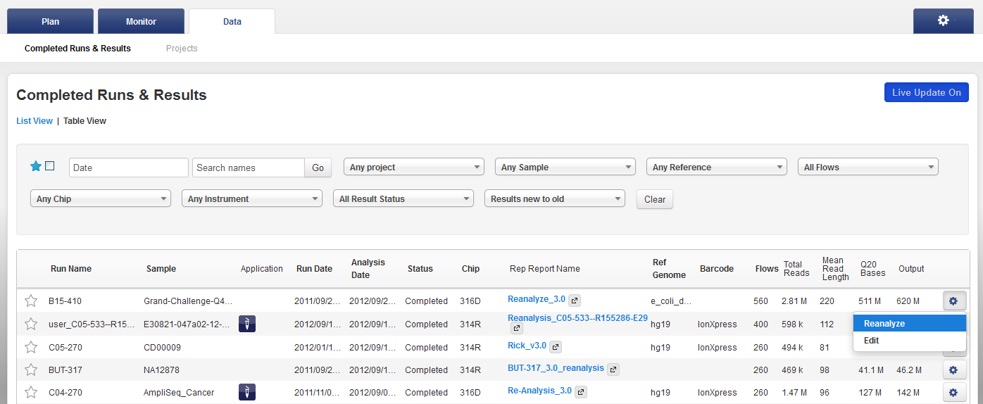

Re-analyze
From the Data tab

Slide 45
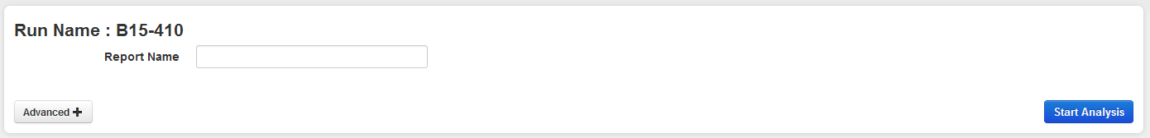
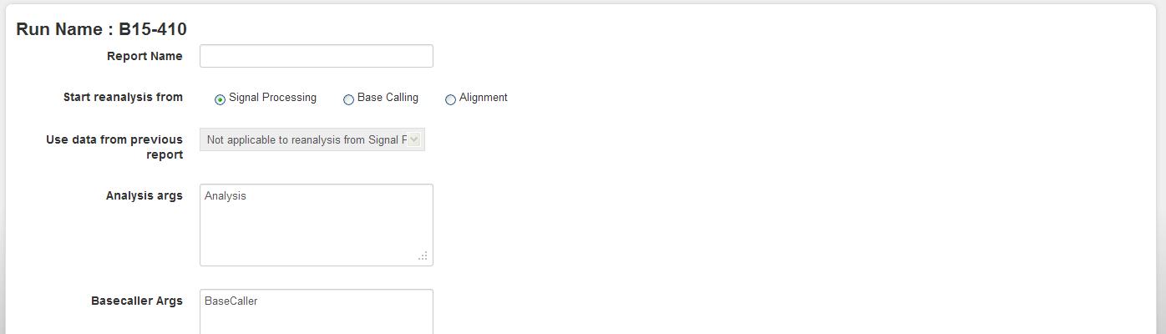
Re-analyze
Click Advanced to set:
Analysis start point
Various analysis settings like base calling, reference…

Slide 46
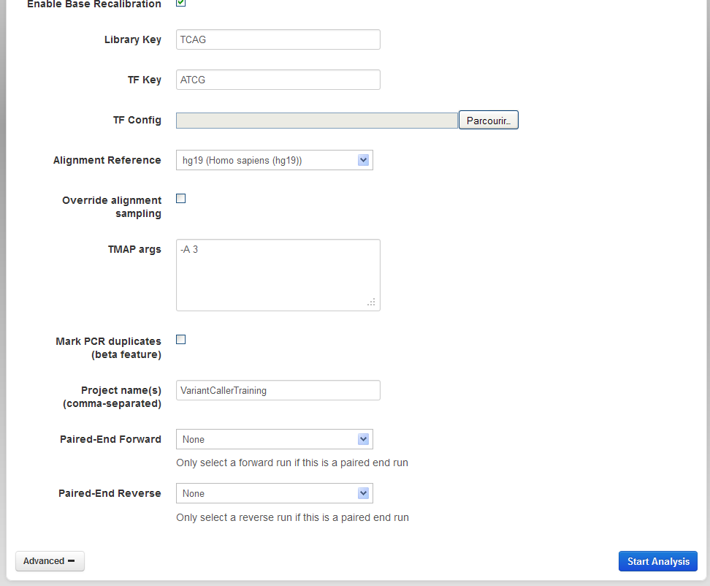
Re-analyze
Browser down to the TMAP args text box

Slide 47
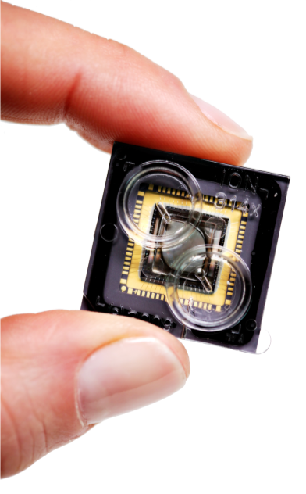

Ion Torrent™ : Semiconductor Sequencing for Life™
Support
Robert David
6178723352
Robert.David@thermofisher
ionsupport@lifetech.com
Call 800-955-6288 in USA
Bioinformatics support
ngs-amsupport@lifetech.com
Jingwei.Ni@thermofisher.com
Online info for Ion Torrent Systems Thermofisher Ion Community
The Chip is the Machine™
Notes:
PLEASE CHANGE TECH SUPPORT NUMBER TO MATCH YOUR REGION’S CONTACT INFORMATION – THIS IS US-ONLY

Slide 48

For Research Use Only. Not for use in diagnostic procedures.
Ion Torrent™ is a Thermo Fisher Scientific brand. © 2014 Thermo Fisher Scientific, Inc. All rights reserved. TaqMan is a registered trademark of Roche Molecular Systems, Inc., used under permission and license. All other trademarks are the property of Thermo Fisher Scientific and its subsidiaries.

